Slide 1
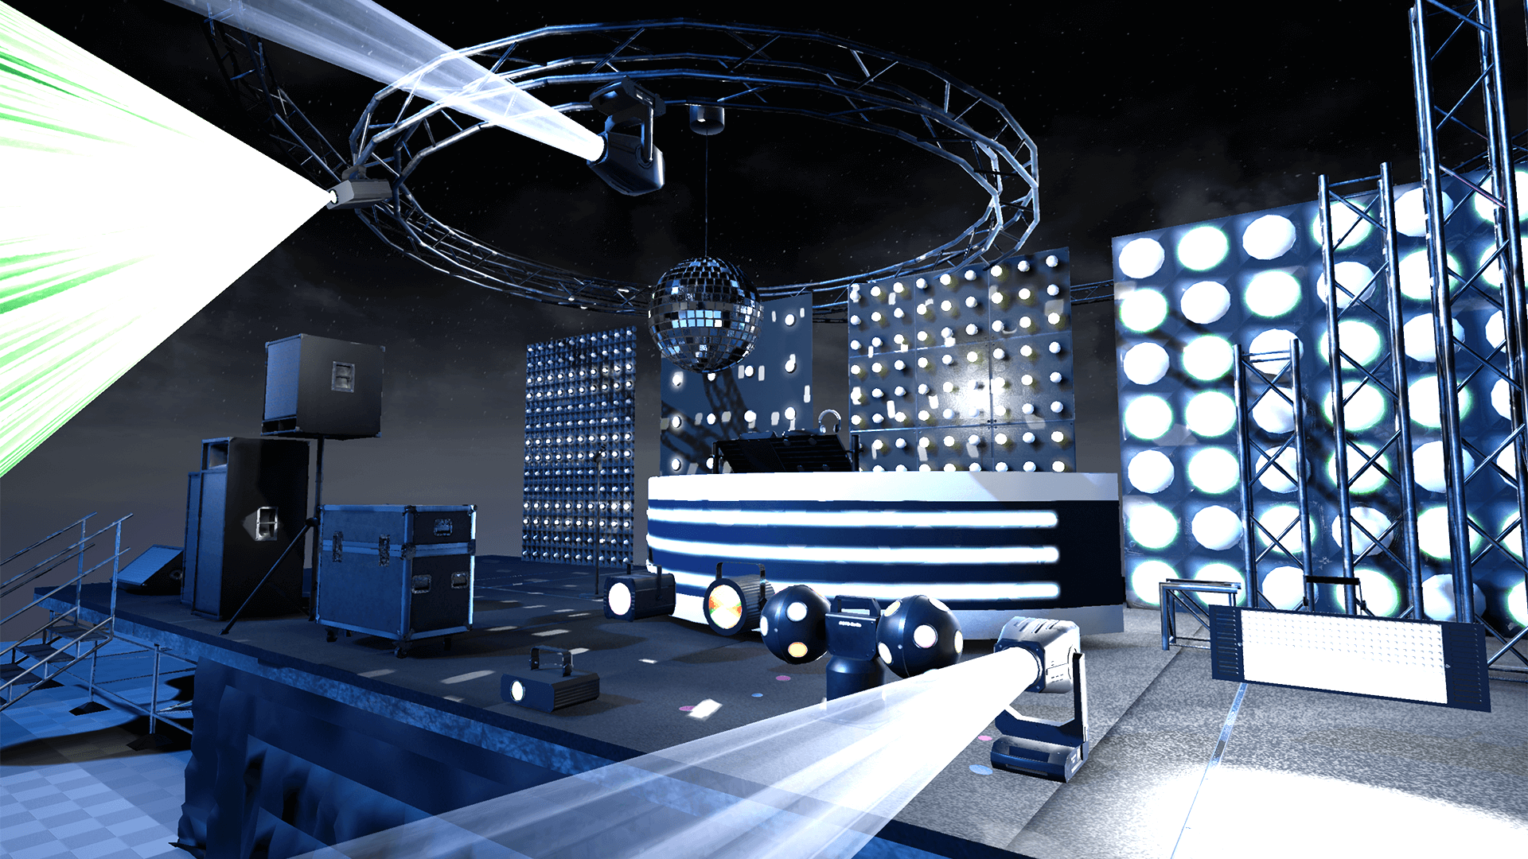
MUSIC SYNCHRONISED STAGE LIGHTS
COMPUTER GRAPHICS COURSE PROJECT
Divyanshu Solanki | 160100070
Pragun Badhan | 160100114
Rahit Sencha | 160100068
Tanya Gupta | 150040010

Slide 2
01
INTRODUCTION
02
PROJECT DESIGN
TABLE OF CONTENTS
03
AUDIO ANALYSIS
04
SPOTLIGHT RANDOMISATION
05
FUTURE WORK

Slide 3
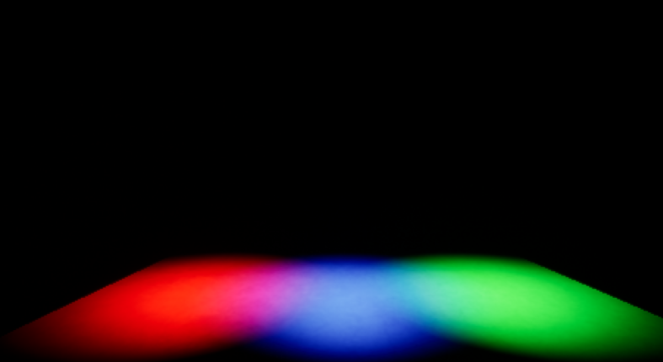
01 INTRODUCTION

Slide 4
NEED FOR MUSIC SYNCED LIGHTS
Current scenario is that there is a person who controls the lights, its movement and its intensity in association with the music. We would like to remove this human part and automate the process. This will help reduce costs and remove errors.
Started with familiarizing with the software Unreal Engine and implemented a basic stage light control using time delay
DEMO

Slide 5
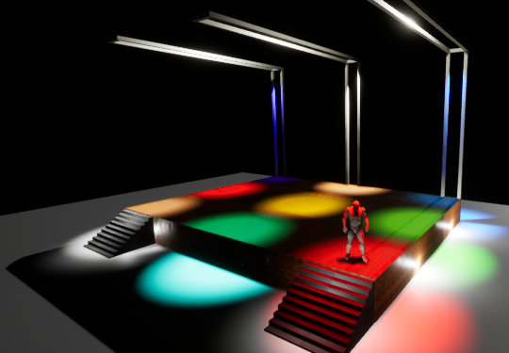
02 PROJECT DESIGN

Slide 6
STAGE MODELLING
Floor for audience
A raised stage for singer and
3*3 spotlight grid whose intensity changes in real time as per characteristics of music.
A singer was imported from existing templates
Three overhead ceiling bars to support spotlights
Static illumination lights around the platform and on ceiling for environment illumination
Two entry staircases
LightMass Importance Volume - To reduce graphics rendering load on GPU

Slide 7
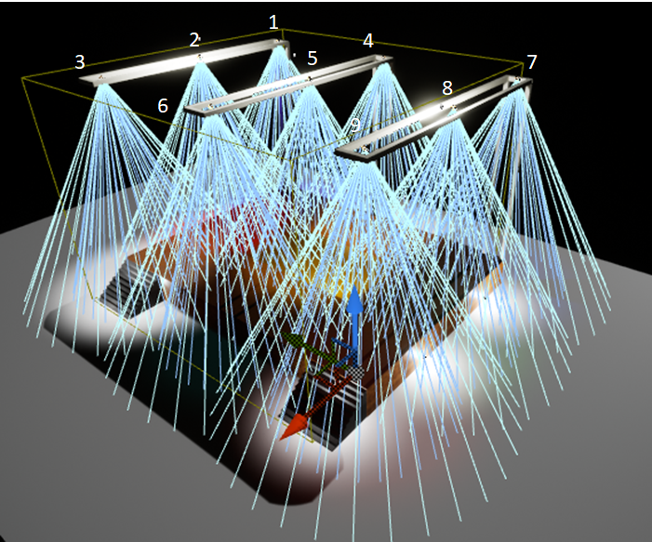
LIGHTS
– Intensity determines how much energy the light outputs into the scene.
– Light Color will adjust the color of the light and the sprite that represents the light in the editor will change its color to match.
– Attenuation Radius of the light sets the reach of the light and defines what objects it will affect
– Source Radius and Source Length define the size of specular highlights on surfaces.
– Static lights are those whose intensity remains constant throughout the simulation
– Outer cone angle and Inner cone angle of spotlights for directing light as required

Slide 8
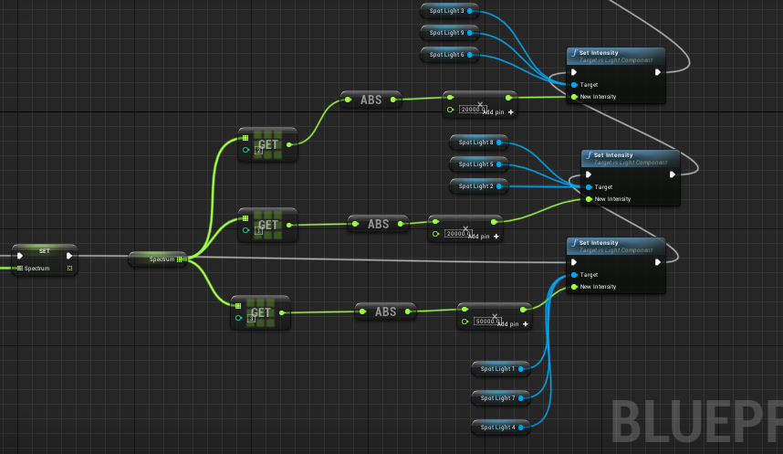
SPOTLIGHT ANIMATION DESIGN
SMOOTH
Blueprint allows for visual scripting of simulation events.
DEMO

Slide 9
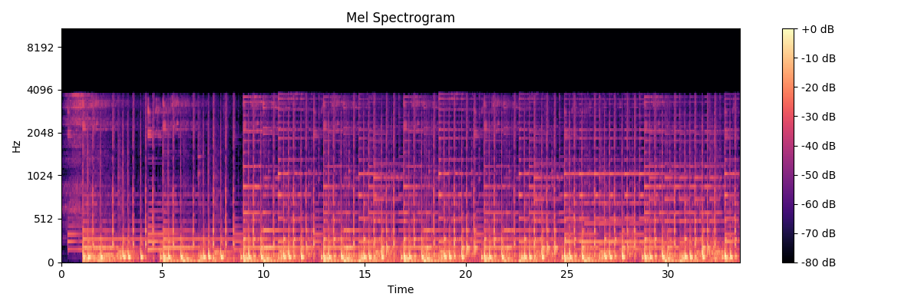
03 AUDIO ANALYSIS
The analysis of audio was performed in MATLAB and then, due to limited functionalities of MATLAB and open-source nature of Python, using the Librosa library of Python.

Slide 10
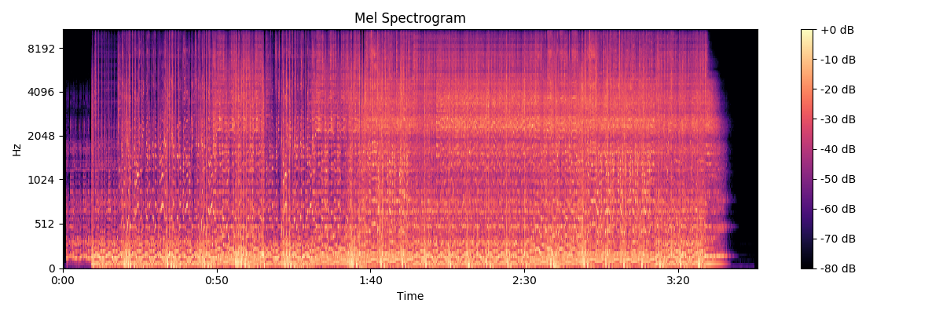
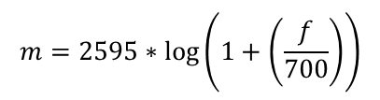
MEL SPECTOGRAM
A spectrogram is a visual representation of the spectrum of frequencies of a signal as it varies with time. A Mel scale is a widely used scale in music which converts the frequencies (Hz) to mels as:
$$m=2595∗\log\left(1+\left(\frac{f}{700}\right)\right)$$
A Mel Spectrogram shows which frequencies occur in the audio and at which time with what power/intensity. Hence it is a 3D graph and Librosa uses colour gradients to show the power values.
The spectrogram plot for Nirvana’s 1992 song “Come As You Are”

Slide 11
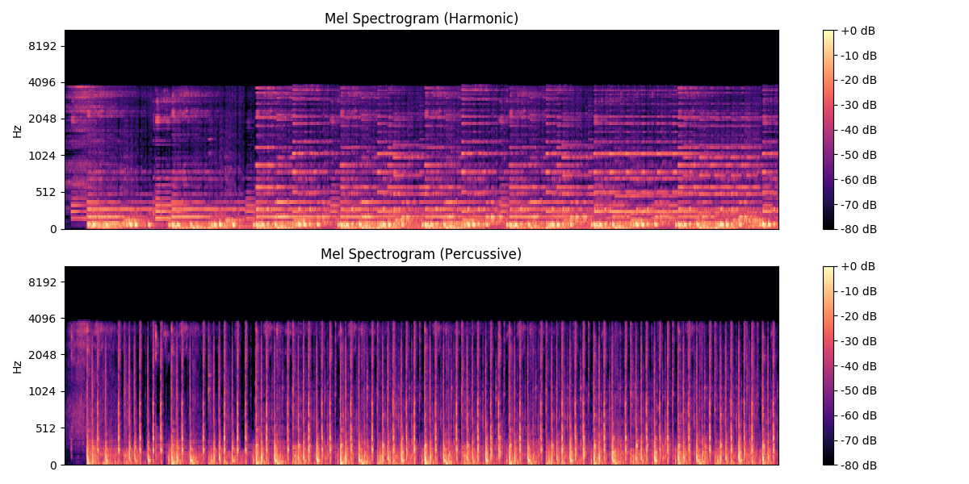
SEPARATING HARMONIC AND PERCUSSION COMPONENTS
The percussive components of the audio correspond to the sound from two colliding objects, for example, drums. Percussive sounds do not have a pitch but a very clear localization in time.
Harmonic sounds are perceived to have a certain pitch, for example a violin sound. Usually, a note played on an instrument (say piano) has onset of percussion (hammer strung on piano strings) followed by a harmonic tone (from the vibration of the strings)

Slide 12
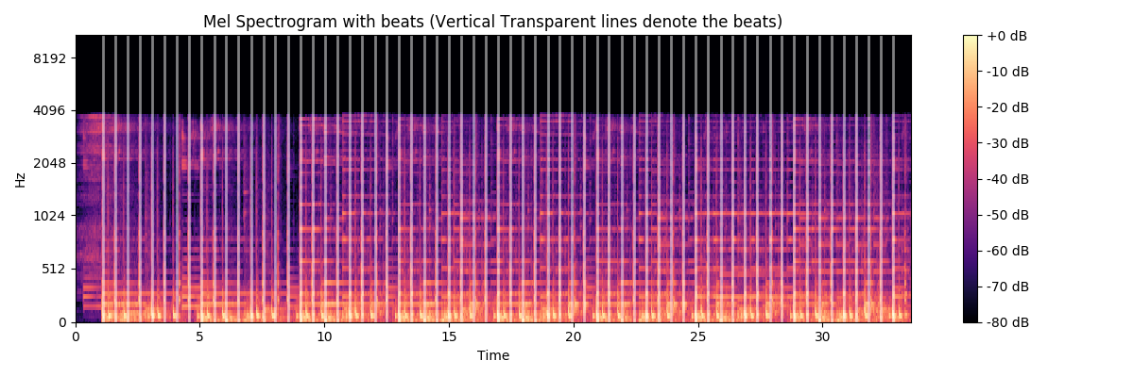
BEAT TRACKING AND TEMPO
Beat tracking simply means finding the time stamps where a listener “taps feet”, which is either the onset from a musical instrument which is regularly spaced as a part of the musical rhythm.
The spectrogram with beats shown (transparent vertical lines) is generated

Slide 13
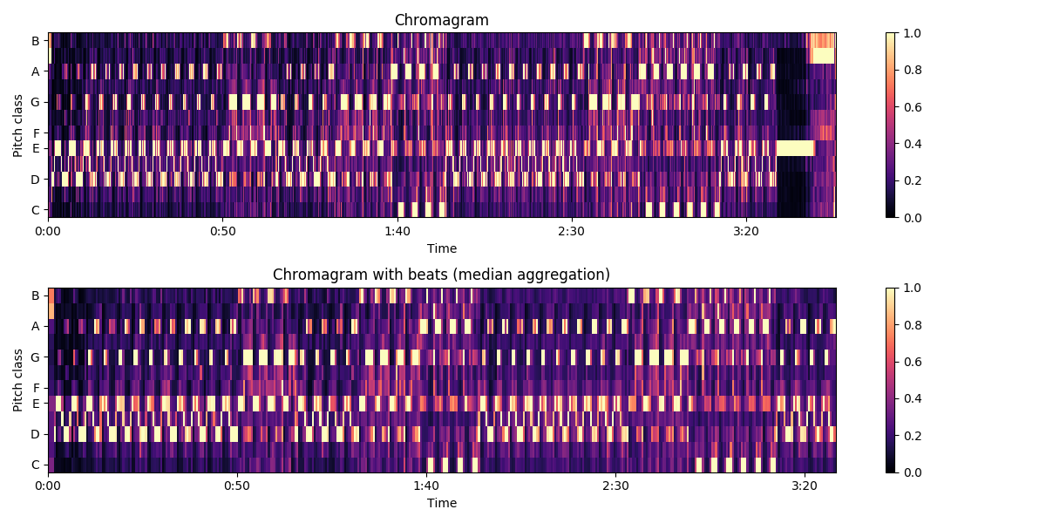
CHROMAGRAM
A chromagram represents what pitch classes belong in a sound and its various components. A pitch class is the set of all pitches which are a whole number of octaves apart. A chromagram is a 3-D graph showing the power/intensity of each pitch class at a time instant in the audio sample. This is particularly useful for us as the onset of an instrument can be tracked in the chromogram and correspondingly the light can be moved and the duration for which it is lit.
The chromagram generated for Nirvana’s 1992 song “Come As You Are”
DEMO

Slide 14
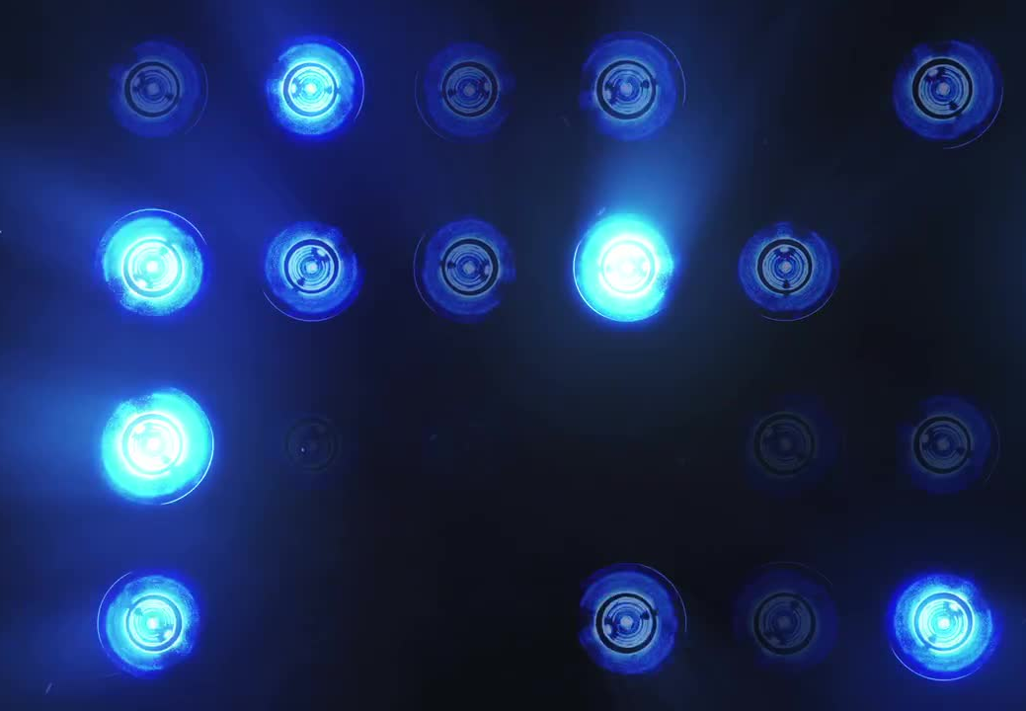
04 SPOTLIGHT RANDOMISATION

Slide 15
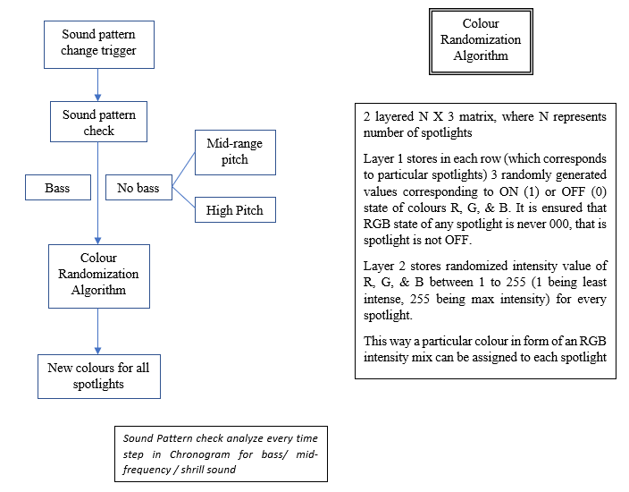
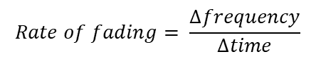
SPOTLIGHT CONTROL
Randomize colors of each spotlight when a beat or sound pattern is changed
Control the flickering frequency based on beat frequency
Control the flicker intensity based on beat amplitude for sections of concert with beats in the song
For beat-less, slow sections, control fade in and fade out of lights
$$Rate of fading= \frac{∆frequency}{∆time}$$
DEMO

Slide 16

05 FUTURE WORK

Slide 17
EXPANSION ON CURRENT WORK
POST-PROCESSING
CONNECTING
Strobes, black out, bright white flashes, hue shifts to make lights match the music
Automatic connection of the spotlight control code with audio analysis code
MACHINE LEARNING
REAL-TIME INPUT
INCLUDE CONTROLS
Genre identification in music can be effectively implemented using Neural Networks
Currently, we are limited to music files already stored in system
Control of the rotation and solid angle of the spotlight cone, lasers & artificial fog

Slide 18
THANK YOU!
Notes:
Wang, ShuaiShuai, et al. "State estimation for quadrupedal using linear inverted pendulum model." 2017 2nd international conference on advanced Robotics and Mechatronics (ICARM). IEEE, 2017.
Focchi, Michele, et al. "Heuristic planning for rough terrain locomotion in presence of external disturbances and variable perception quality." Advances in Robotics Research: From Lab to Market. Springer, Cham, 2020. 165-209.
Raibert, Marc, et al. "Bigdog, the rough-terrain quadruped robot." IFAC Proceedings Volumes 41.2 (2008): 10822-10825.
Chung, Jae-Wook, et al. "Posture stabilization strategy for a trotting point-foot quadruped robot." Journal of Intelligent & Robotic Systems 72.3-4 (2013): 325-341.
Khorram, Mahdi, and S. Ali A. Moosavian. "Push recovery of a quadruped robot on challenging terrains." Robotica 35.8 (2017): 1670-1689.
Havoutis, Ioannis, et al. "Onboard perception-based trotting and crawling with the hydraulic quadruped robot (HyQ)." 2013 IEEE/RSJ International Conference on Intelligent Robots and Systems. IEEE, 2013.

